Slide 1
Covid-19 Analysis
United States

Slide 2
Datasets
Number of cases & deaths due to covid
This data set has been obtained from the website – who.int.
It contains the details about the number of cases and deaths that have been recorded every month across each state.
Using this dataset, we are looking at the trends as to which state has the highest percentage of cases and deaths.
This data is from Jan 2020 – Feb 2022
2. Population dataset
This data set has been obtained from the website – NY Times
It contains the details of the population of each state in the US.
Using this dataset, we have calculated the percentages of cases, vaccinations and deaths so that all the states can be looked at in the same scale and be comparable. This data is from Jan 2020 – Jan 2022
3. Vaccination dataset
This data set has been obtained from the website - NY Times.
It contains the information about the number of people vaccinated in each state from Jan 2021 – Feb 2022.
Using this data, we got the insights about how the vaccinations effected the covid situation.
4. Government policies for Covid dataset
This data set has been obtained from the website - https://www.openicpsr.org/openicpsr , figshare.com.
It contains the details about which policies each state in the United States has implemented, when it has been brought into implementation, when it ended. This dataset has only 2020 data
Using this dataset, we are determining how effective each of these policies has been in battling with the corona virus.

Slide 3
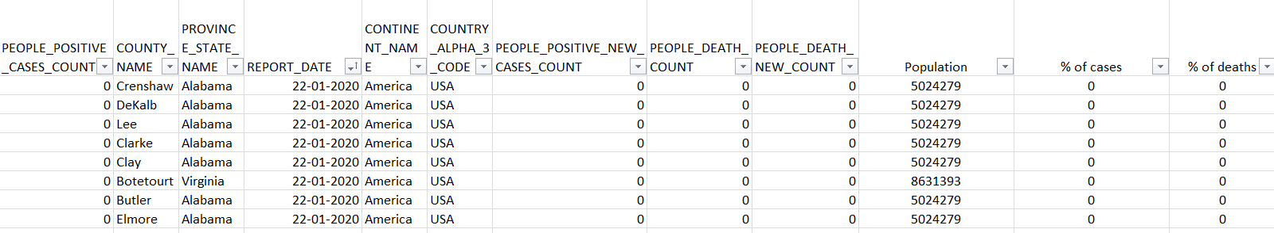
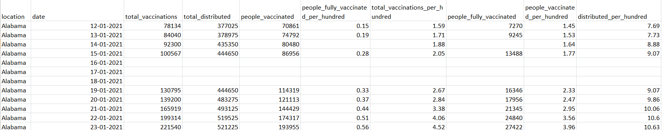
Datasets

Slide 4
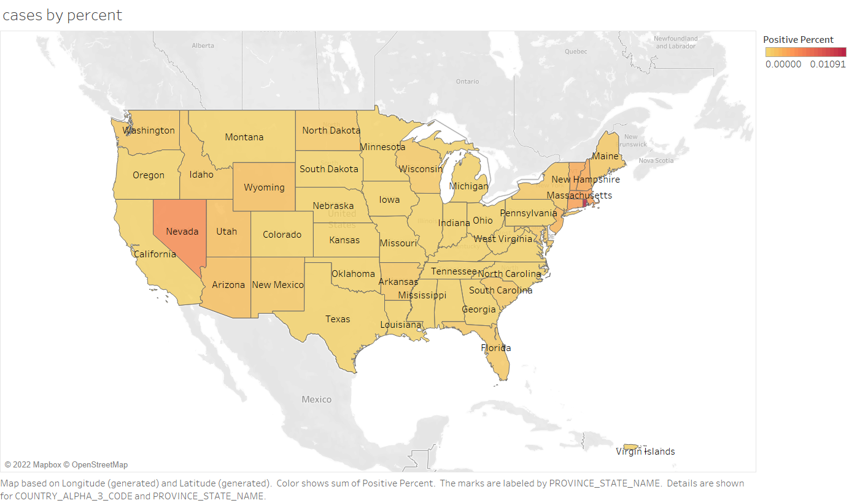

Slide 5
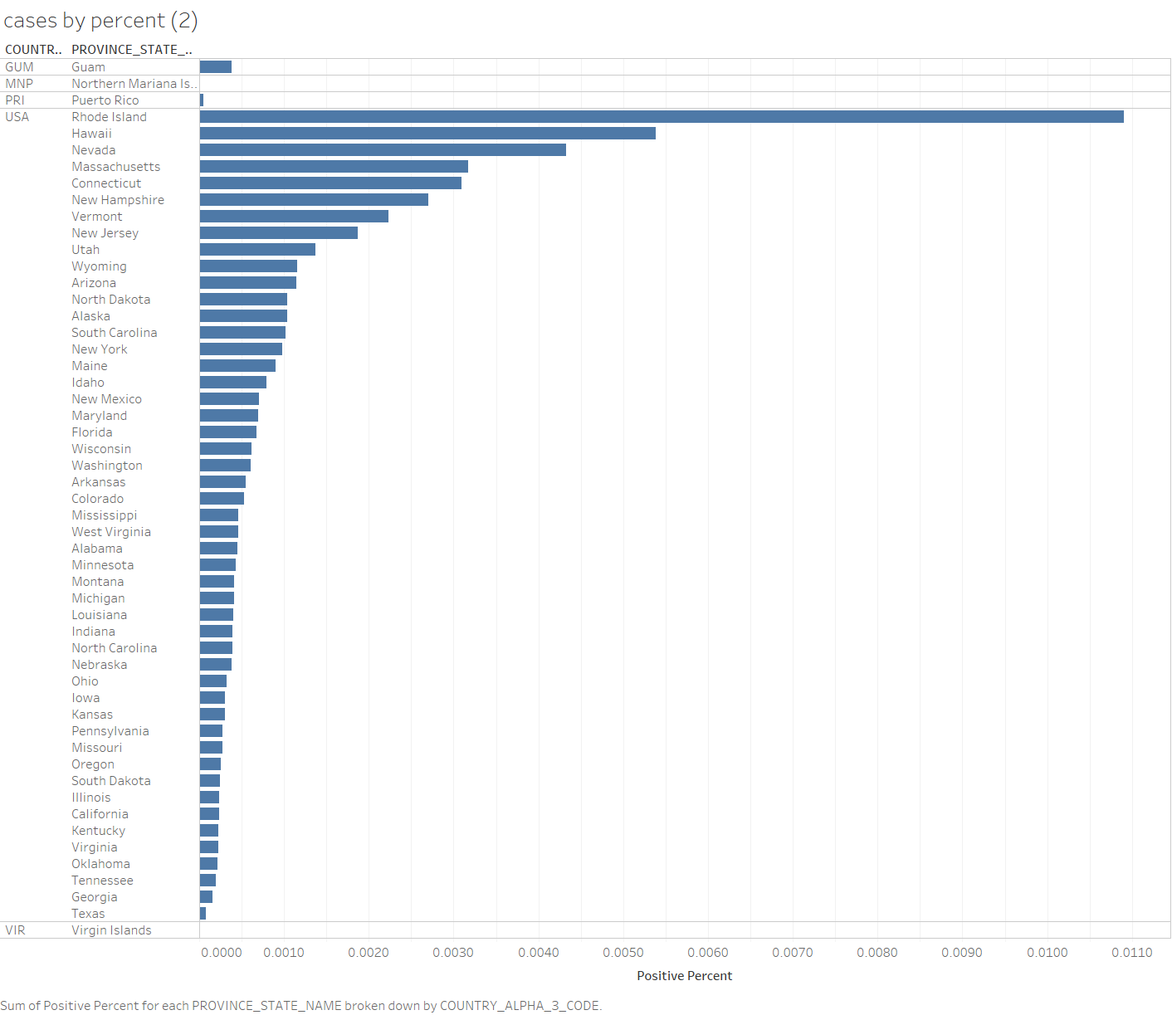
Highest Percentage of Cases
Rhode Island
Hawaii
Nevada
Massachusetts
Connecticut
Lowest Percentage of cases –
Texas
Georgia
Tennessee
Oklahoma
Virginia

Slide 6
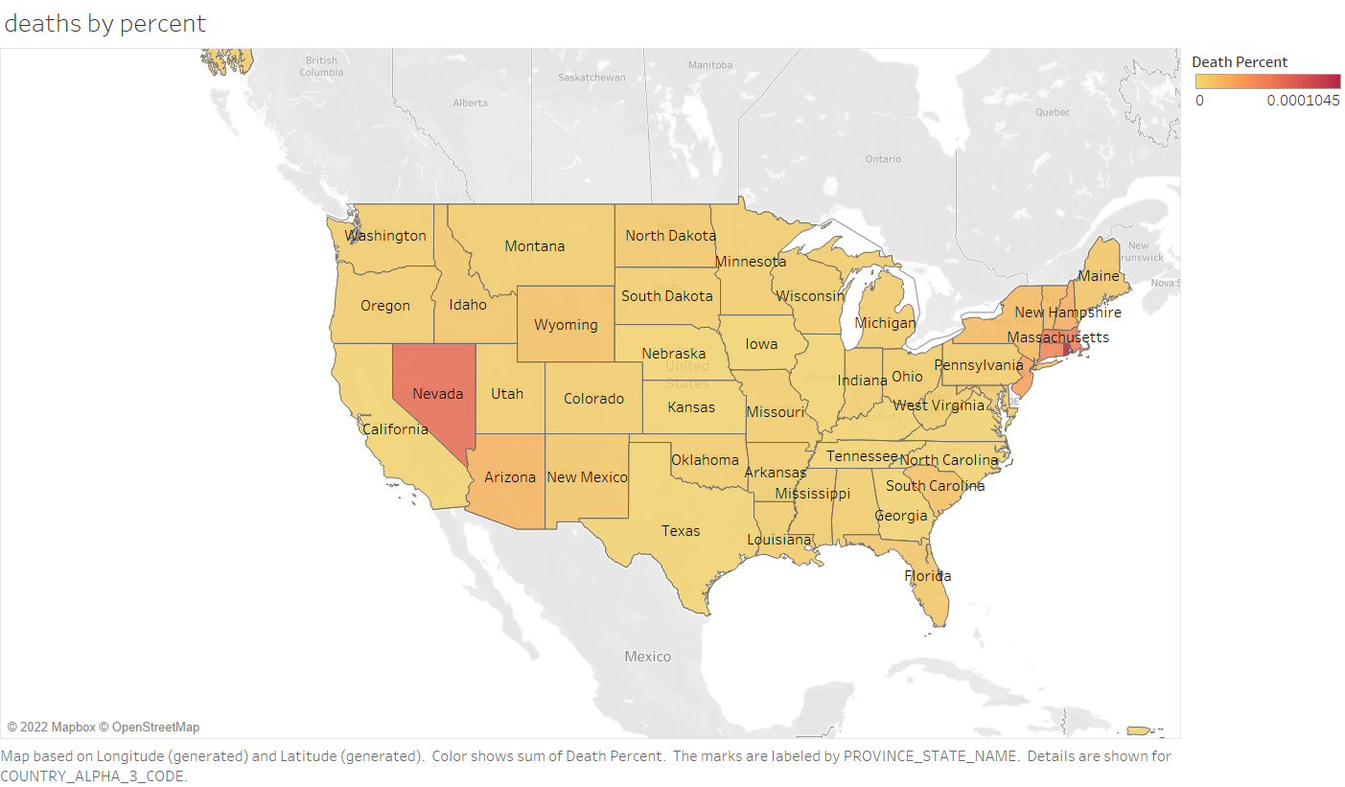

Slide 7
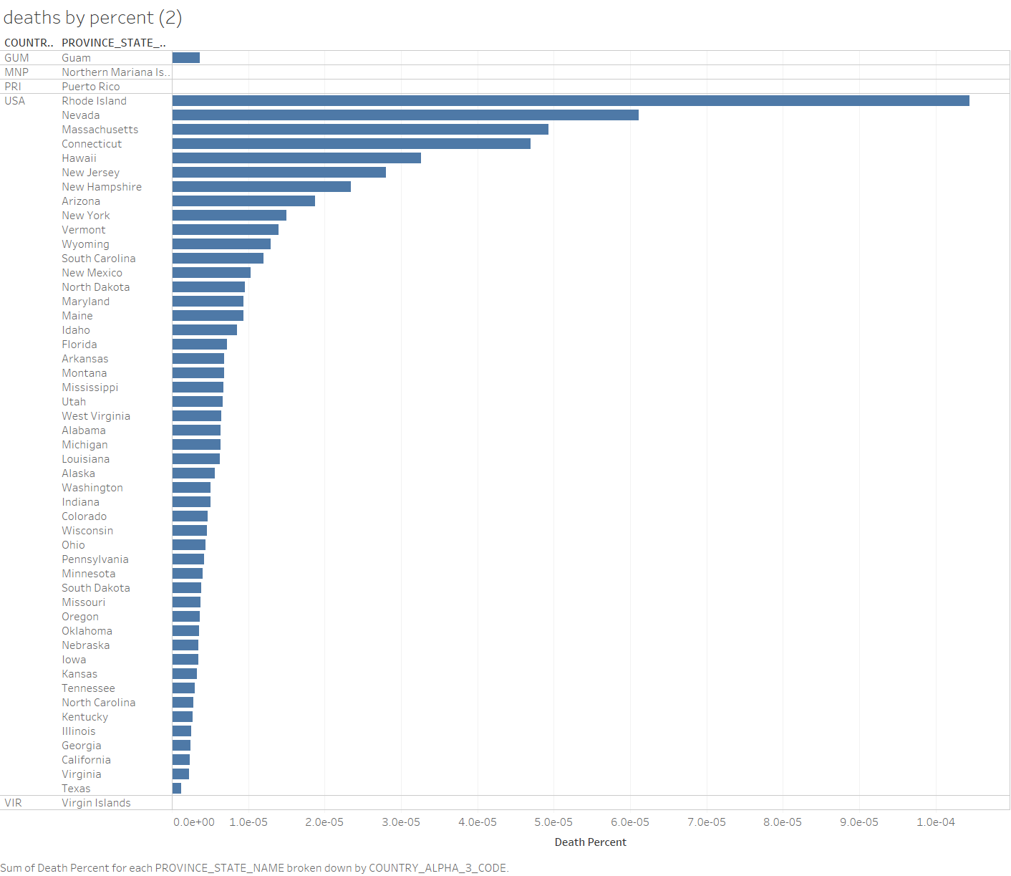
Highest Percentage of deaths
Rhode Island
Nevada
Massachusetts
Connecticut
Hawaii
Lowest percentage of deaths–
Texas
Virginia
California
Georgia
Illinois

Slide 8
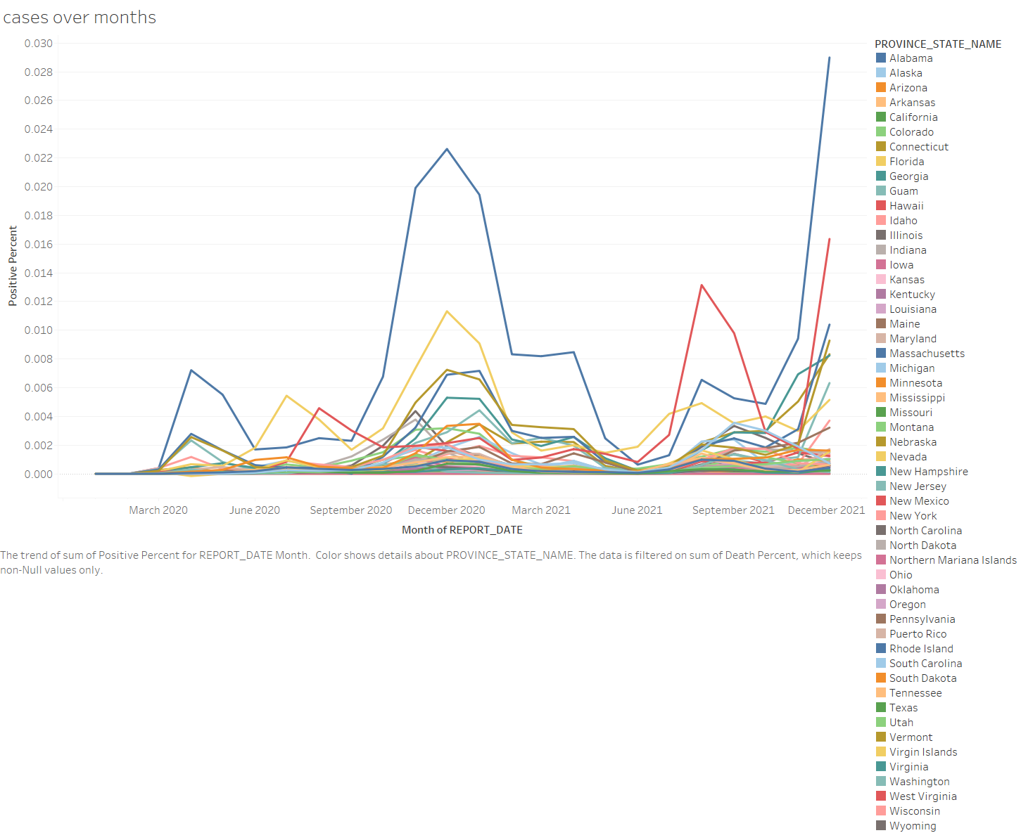

Slide 9
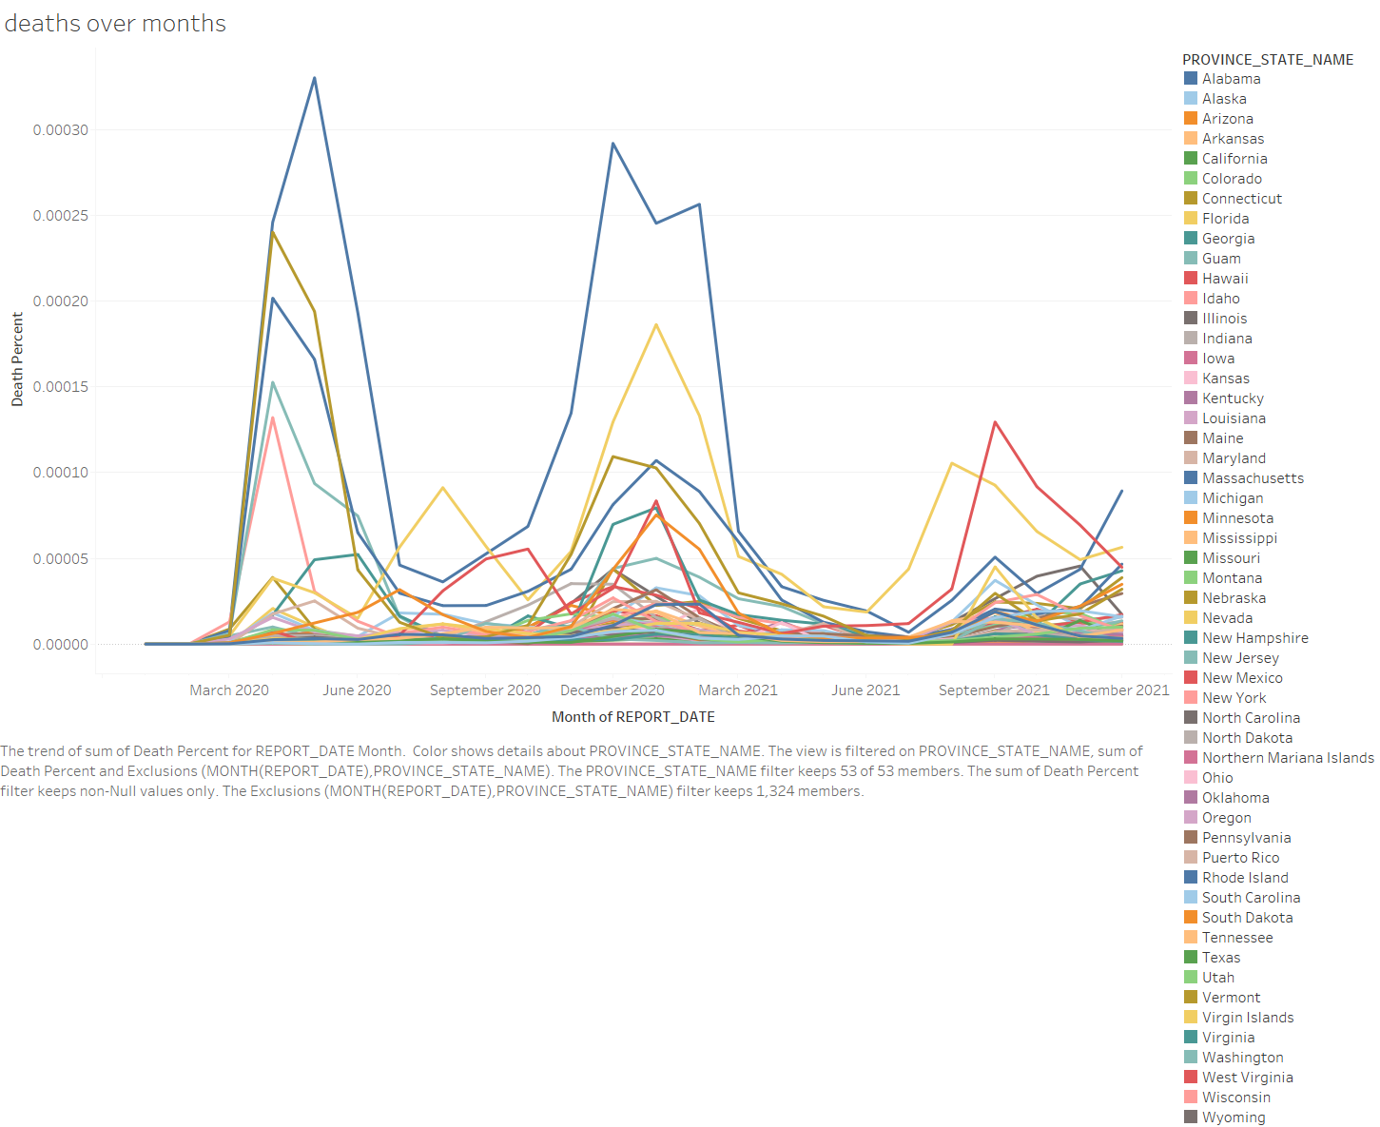

Slide 10
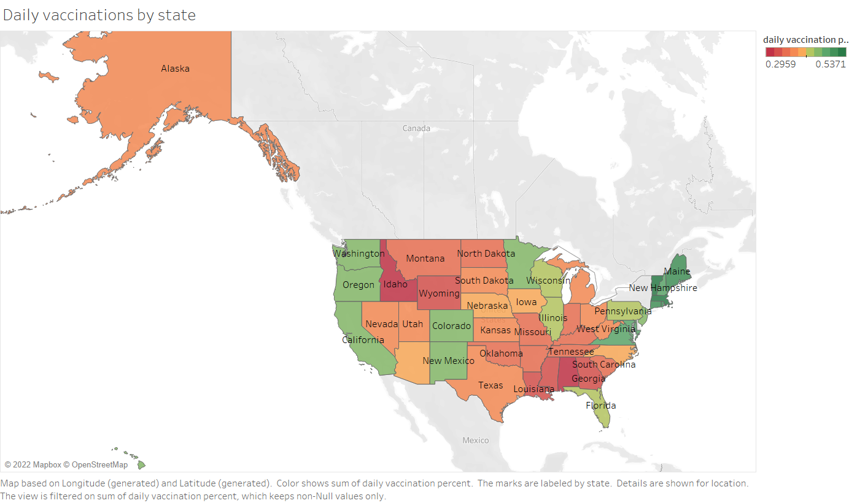

Slide 11
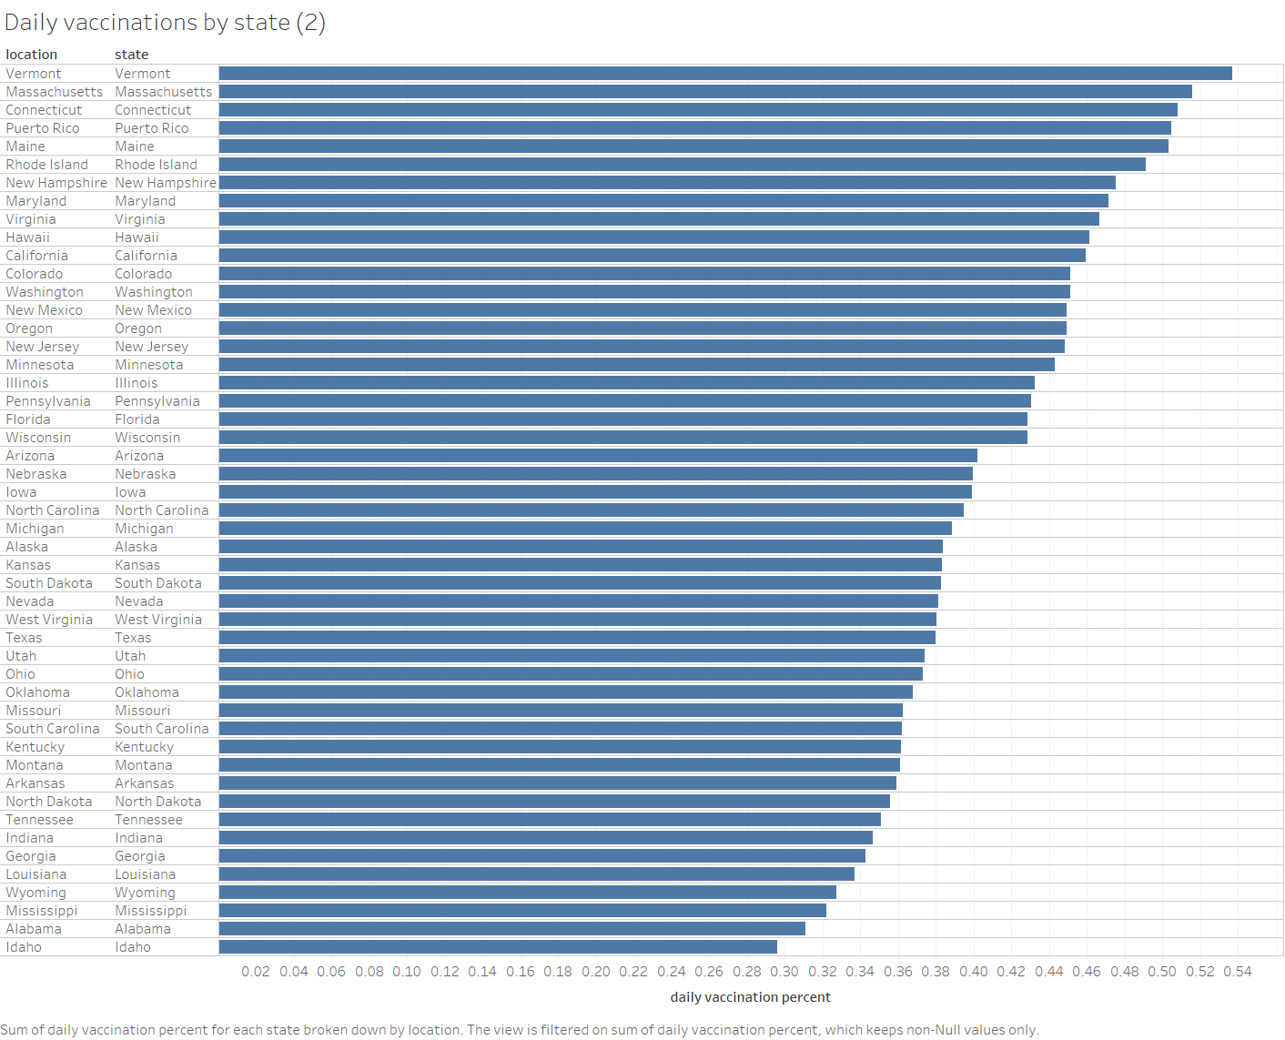
Highest daily vaccination percentages –
Vermont
Massachusetts
Connecticut
Puerto Rico
Maine
Lowest daily vaccination percentages –
Idaho
Alabama
Mississippi
Wyoming
Louisiana

Slide 12
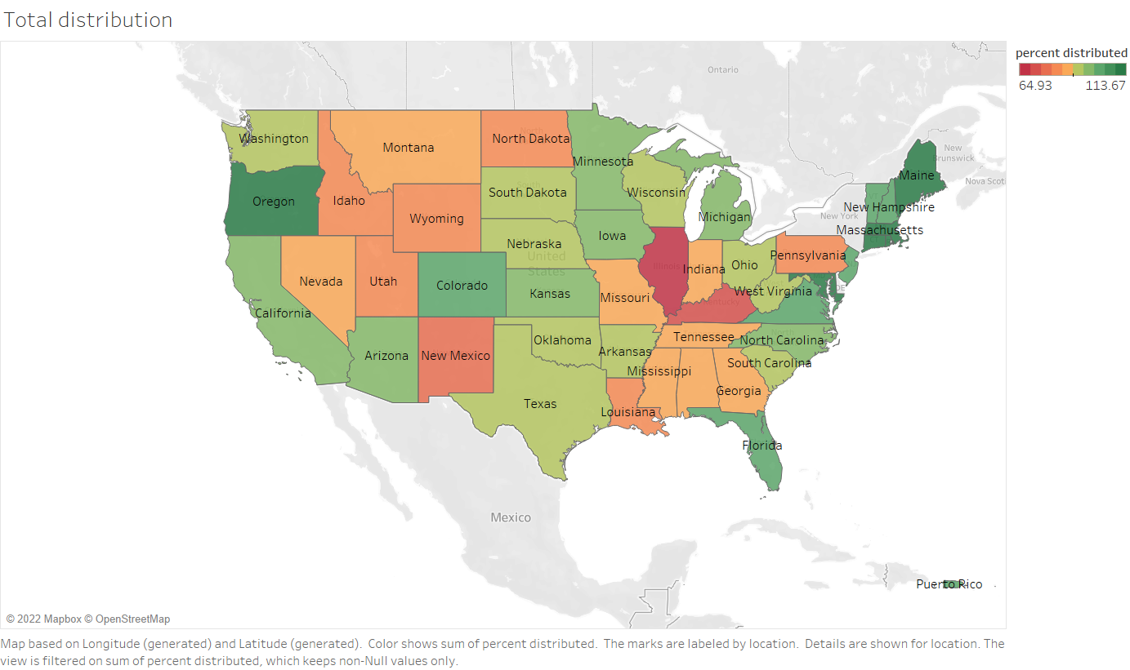

Slide 13
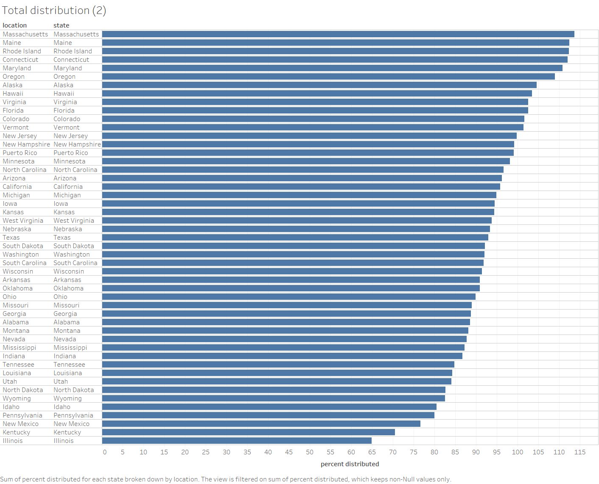
Highest percentage of Distribution of Vaccines
Massachusetts
Rhode Island
Connecticut
Maryland
Oregon
Lowest percentage of Distribution of Vaccines –
Illinois
Kentucky
New Mexico
Pennsylvania
Idaho

Slide 14
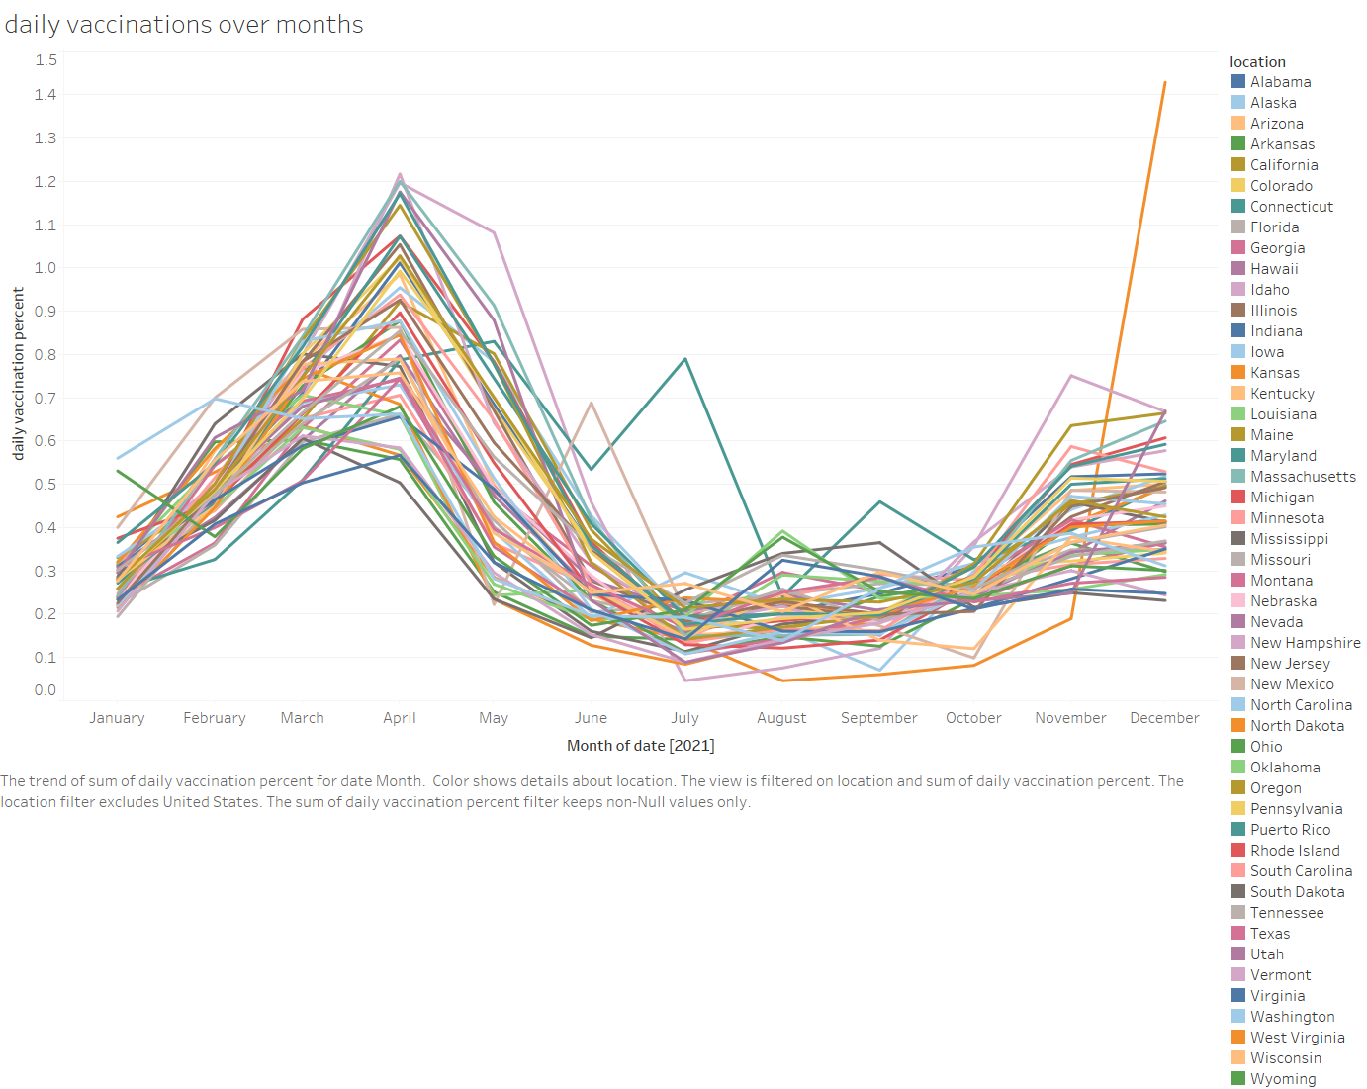

Slide 15
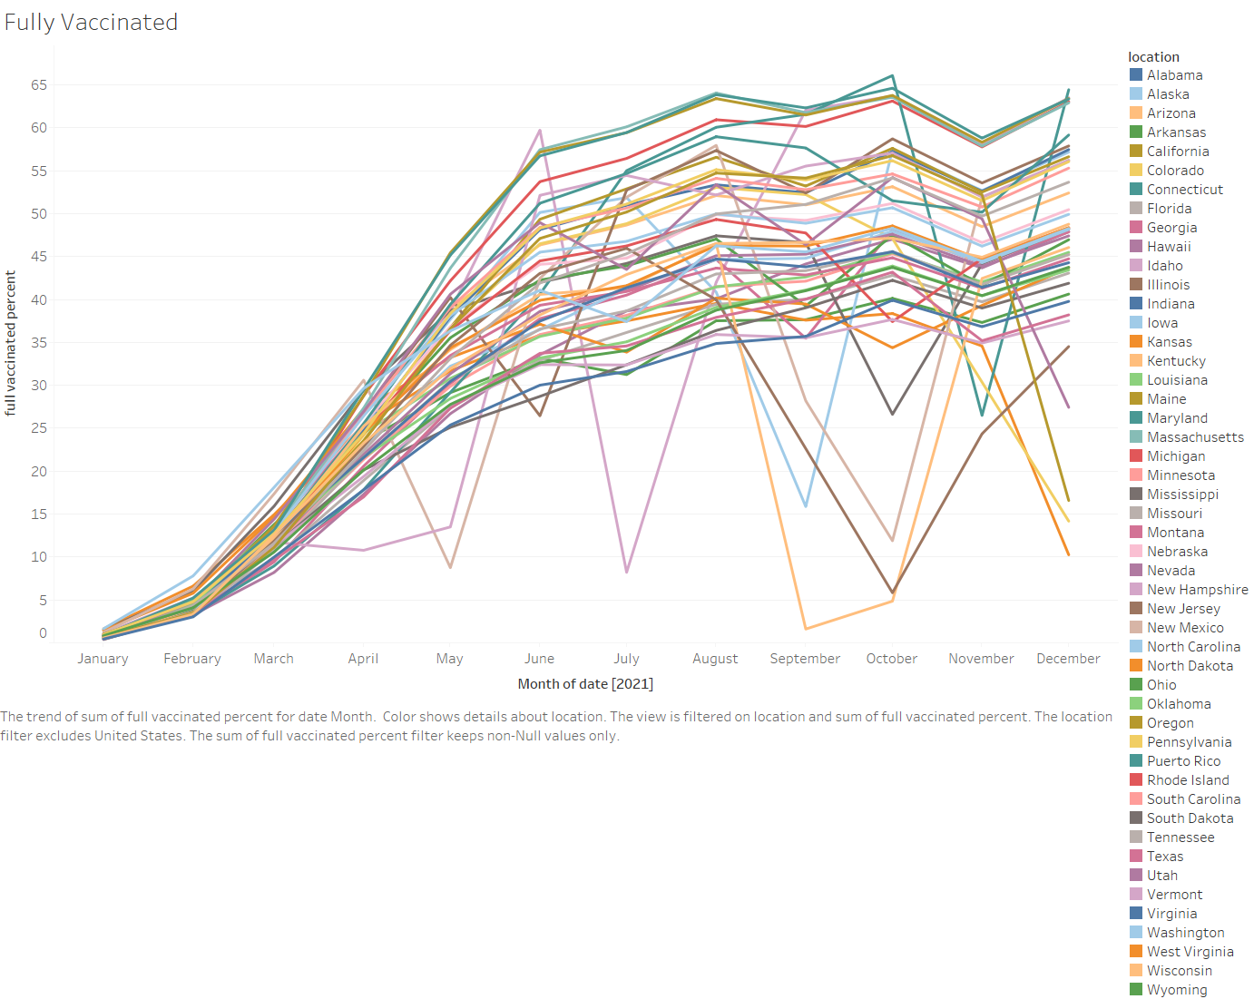

Slide 16
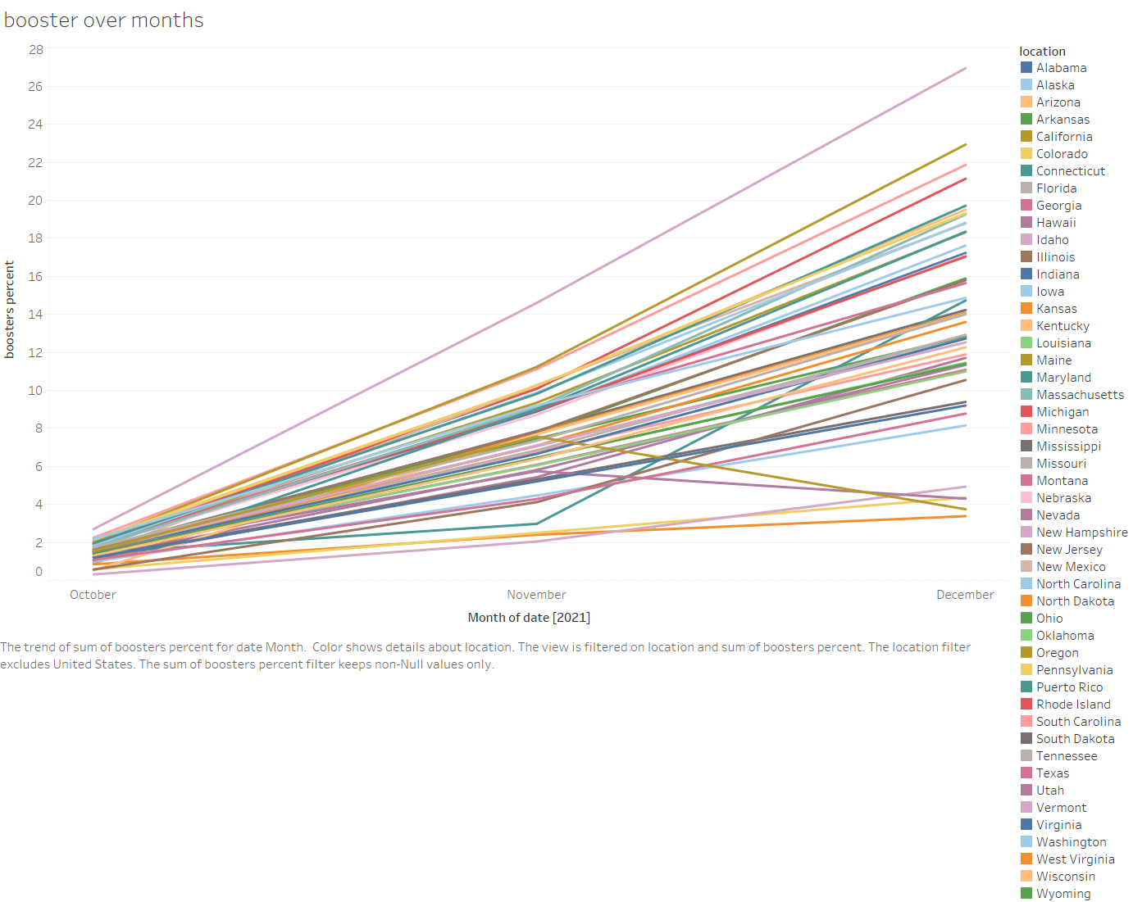

Slide 17
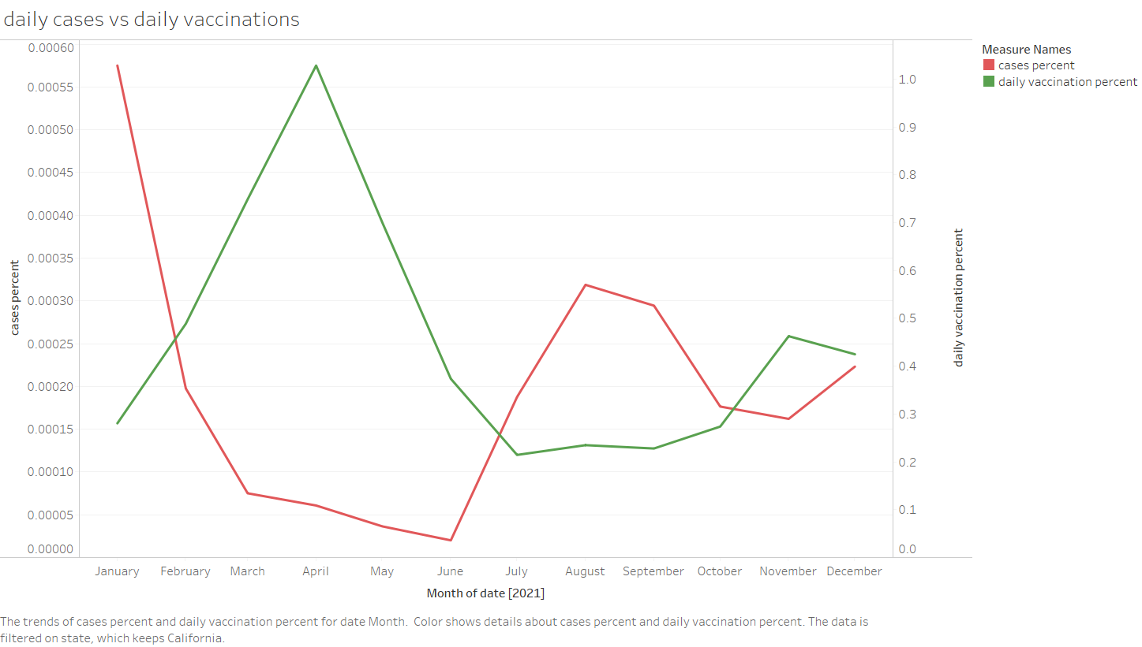

Slide 18
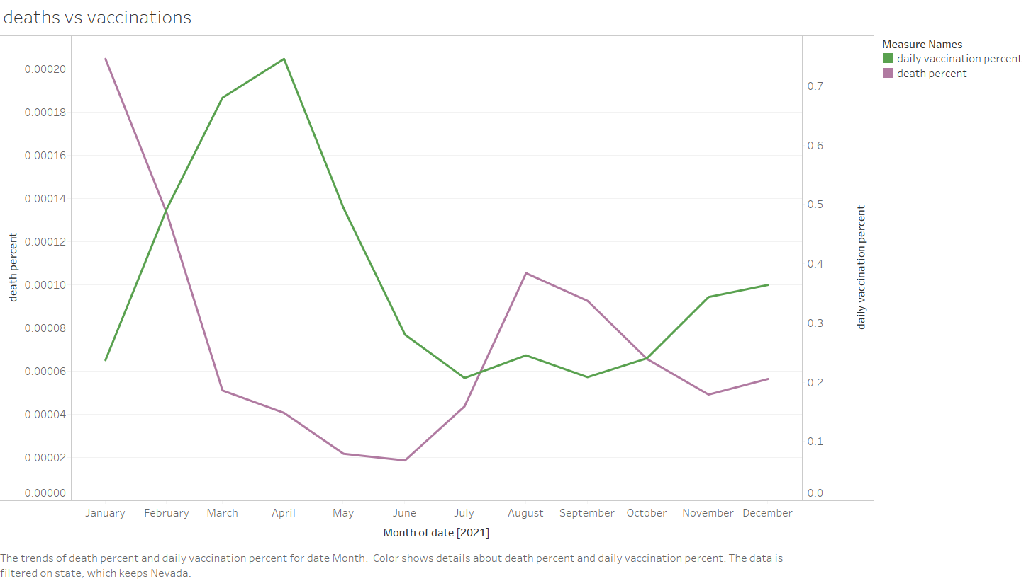

Slide 19
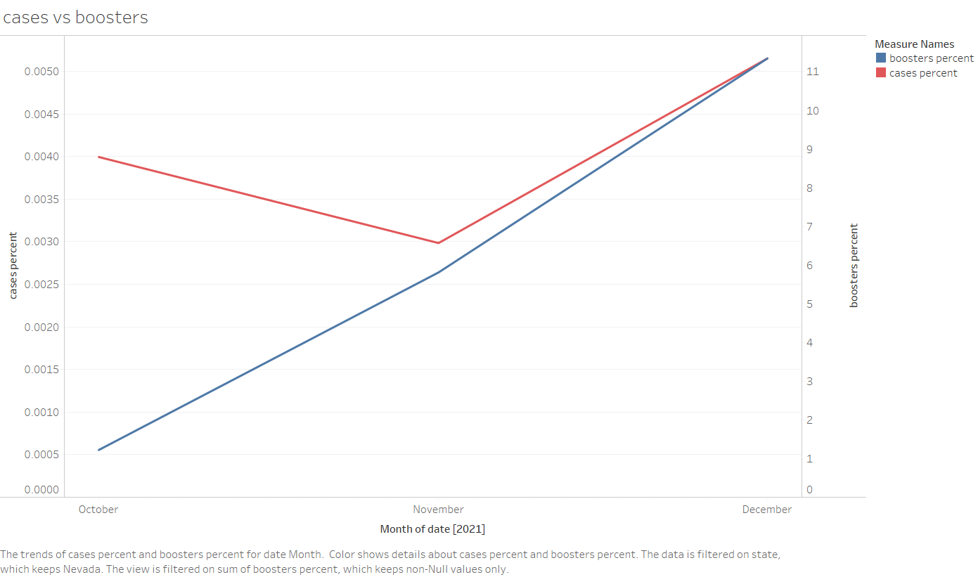

Slide 20
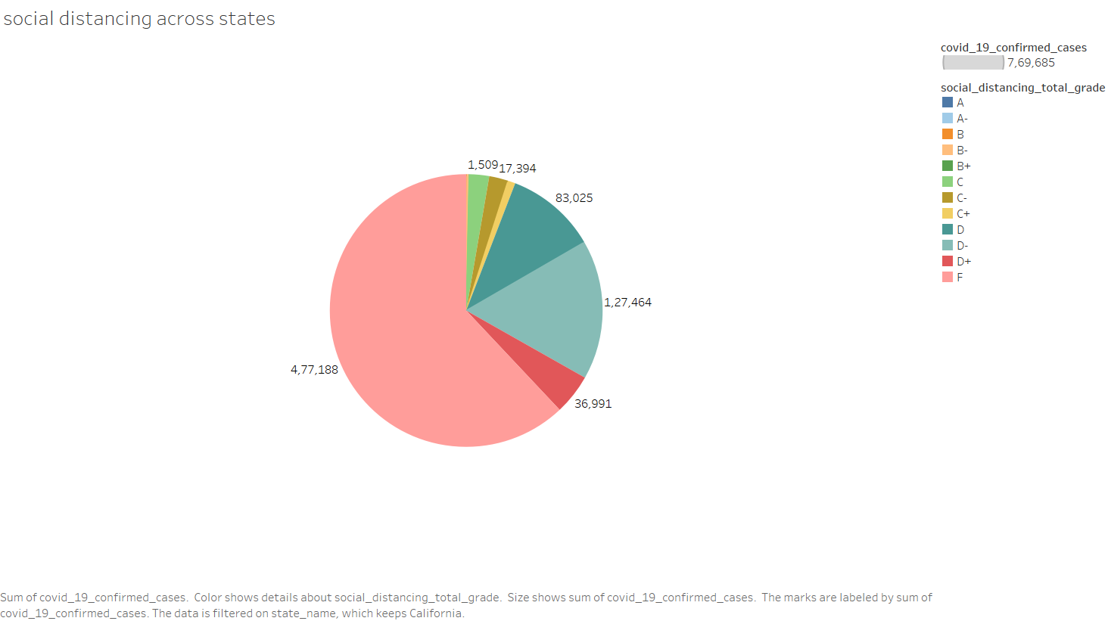

Slide 21
CONCLUSION
Mask Mandate & Social Distancing DO MATTER
Which state you should prefer for dating?
Texas
Oregon
California
Which states to stay away from?
Nevada
Rhode Island

